Slide 1
Software Project Management (SPM) Unit- V
Prepared by: Neha Tripathi

Slide 2
SPM Size Estimation
Lecture 1

Slide 3
Software Project Management Basics
Software project management(SPM) in software engineering is an important factor driving the project from product conception till completion.
It is the umbrella activities of SDLC i.e., spans the overall software development
Project Manager: A software project, however, big or small employs project manager.
The important duty for a software project management is:
To write project proposal,
Prepare project cost estimation, schedule and staffing
Help and keep the group of software developers motivated
Building up teams morale
Steer project towards successful completion
An effective software project management requires proper project planning, project monitoring and project control.

Slide 4
SPM activities
An effective software project management requires:
- project planning,
- project monitoring and project control.
Project planning
- After feasibility study phase if a project is found to be feasible then the project manager begins project planning.
- Project manager completes this activity before development work starts.
Project monitoring and project control.
- After each phase a review is carried out for this.

Slide 5
Project planning
Project estimation → When a project is finalized then several estimations need to be made.
- Project size: What will be problem complexity in terms of the effort and time required to develop the product.
- Cost estimation is required that would be required for project.
- Time estimation is needed that would propose the time in which the project would be in deliverable position.
- Effort estimation is needed to finalize the resource available and required for the project.
Project Schedules → Schedules for manpower and several other resources has to be prepared that would be needed as the project progress.

Slide 6
Continue….
Project staffing → Staff needs to be organized and planned. Analysis has to be done to find out if the existing staff is sufficient for the project or new recruitment is required.
Project risks and management → Possible risks to the project needs to identified and its solution needs to found to let project progress smoothly.
Project miscellenous management → Quality of the product, configuration management plan, etc are some miscellenous task that needs to be planned accordingly.

Slide 7
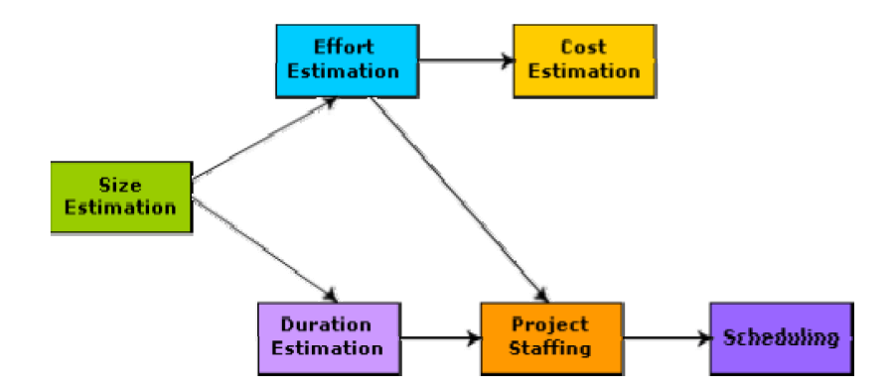
Precedence ordering among planning activities

Slide 8
SPMP Document
Software project manager prepare a document on the basis of decision finalized during the project planning. This document is known as Software Project Management Plan Document or SPMP document.
SPMP document is a well organized document that contains the project planning in detail.
It would have details about project objective, project estimates, project schedules, project resources, project staffing, risk management plans, project monitoring, project control and other miscellenous activities.

Slide 9
SPMP doc Structure/Format
SPMP document is prepared by project manager .Format:
Introduction
- Objectives
- Functions
- Performance issues
- Constraints
Project estimates
- Historical data used
- Estimation techniques details
- Cost, duration, effort estimates
Project Schedule
- Work breakdown
- Gantt and PERT chart

Slide 10
Continue….
Project resource
- Manpower
- Hardware and Software
- Highly skilled professionals
Staff organization
- Team formation and structure
- Management reporting
Risk Management
- Risk analysis
- Risk identification
- Risk abatement methods
Project tracking
Project Control
Miscellenous activities

Slide 11
Project Size Estimation Metrics
It’s important to understand that project size estimation is the most fundamental parameter.
If this is estimated accurately then all other parameters like effort, duration, cost, etc can be determined easily.
At present 2 techniques that are used to estimate project size are
- Lines of code or LOC (Direct Measurement)
- Function point metric (Indirect Measurement )
Both of the above serves as important project size estimation metrics.
Different estimation models are present to estimate various attributes of software.
All the estimation models are derived from past projects.

Slide 12
Lines of code
This estimation is well suited to measure the size of software after the program development.
As the name suggest, LOC count the total number of lines of source code in a project.
Once the software size is estimated using LOC count, the programmer skill level is taken into the account because different developers are involved in the software development process.

Slide 13
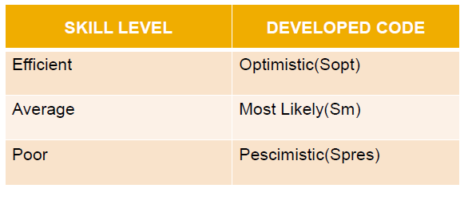
According to experts analysis the programmer skill level is divided into 3 kinds :

Slide 14
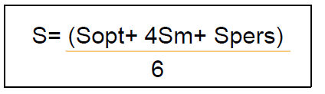
When the software project is expected to have listed kind of codes then the software size is measured by using the following formula :

Slide 15
LOC Numerical
Question : A software system is expected to have a 4600 Sopt, 6900 Sm and 8600 Spers. Find :
1. Expected size of software system.
2. If software development effort is expected as two man years then what is the productivity rate?
3. If software development duration is estimated as 05 months then what is the average man power?
4. If software development cost is estimated as Rs 2500 / man month, what is the development cost of project?
NOTE: Productivity rate means how many number of lines developed in one man/person month effort.(productivity=size/effort)

Slide 16
Solution
1. S = 4600+4*6900 +8600 / 6
= 6800 LOC
2. 02 man year = 24 months
6800 LOC -> 24 months
6800/24 -> 1 month
= 283.3 LOC/man month
3. Man Power = Effort / Duration
24/5 = 5 months
4. Development Cost = Development Effort * Cost/man month
= 24 * 2500
= Rs 60000

Slide 17
Advantages and Disadvantages:
Advantages:
-Universally accepted and is used in many models like COCOMO.
-Estimation is closer to developer’s perspective.
-Simple to use.
Disadvantages:
-Different programming languages contains different number of lines.
- No proper industry standard exist for this technique.
-It is difficult to estimate the size using this technique in early stages of project.

Slide 18
Function point metrics
This estimation is best suited to measure the size of the project before the program development.
In this method, the number and type of functions supported by the software are utilized to find FPC(function point count).
Function point metrics overcomes many of the shortcomings of LOC.
Function point metrics proposes that size of the software project is directly dependent on various functionalities it supports. More the features supported the more would be the size.
This technique helps determine size of the project directly from the problem specification so is really helpful to project managers during project planning while determining size.

Slide 19
Common parameters (5)
Common parameters of software system are considered to measure size of software :
Number of inputs : Functions related to data entering the system.
Number of outputs : Functions related to data exiting the system.
Number of inquires : They leads to data retrieval from system but don’t change the system.
Number of files : Logical files maintained within the system. Log files are not included here.
Number of external interfaces: These are logical files for other applications which are used by our system.

Slide 20
Steps in Function Point Analysis
Count the number of functions of each proposed type.
Compute the Unadjusted Function Points(UFP).
Find Total Degree of Influence(TDI).
Compute Value Adjustment Factor(VAF).
Find the Function Point Count(FPC).

Slide 21
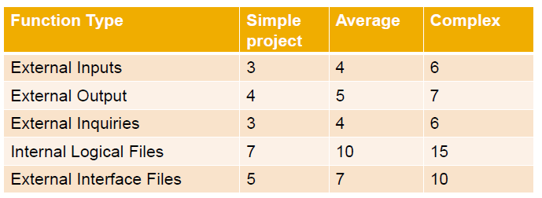
Compute the Unadjusted Function Points(UFP):
Categorize each of the five function types as simple, average or complex based on their complexity.
According to project level of complexity different emperical weights are calculated. Sample table:

Slide 22
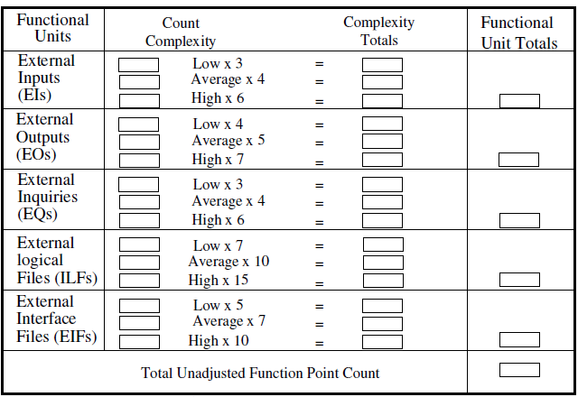
UFP calculation table

Slide 23
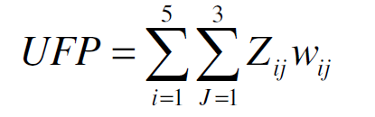
Continue…
The weighting factors are identified for all functional units and multiplied with the functional units accordingly.
The procedure for the calculation of Unadjusted Function Point (UFP) is given in the table above.
The procedure for the calculation of UFP in mathematical form is given below:
Where i indicate the row and j indicates the column of Table 1
Wij : It is the entry of the ith row and jth column of the table 1
Zij : It is the count of the number of functional units of Type i that have been classified as having the complexity corresponding to column j.

Slide 24
Continue…
Find Total Degree of Influence(TDI:0-5) or CAF , complexity adjustment factor([0.65 + 0.01 x ∑ Fi ]. The Fi (i=1 to 14) are the degree of influence(refer next slide for this)
Compute Value Adjustment Factor(VAF):
VAF = (TDI * 0.01) + 0.65 or VAF= ([0.65 + 0.01 x ∑ Fi ].
Find the Function Point Count:
FPC = UFP * VAF

Slide 25
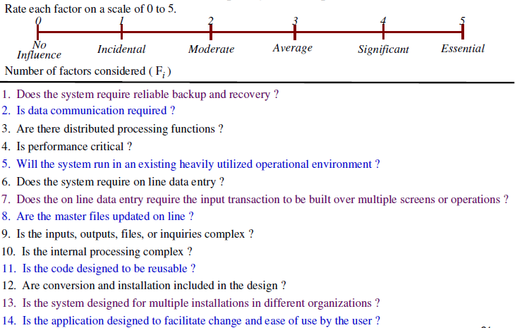
Continue…

Slide 26
Advantages and Disadvantages :
Advantages:
- It can be easily used in the early stages of project planning.
- It is independent on the programming language.
- It can be used to compare different projects even if they use different technologies(database, language etc).
Disadvantages:
- It is not good for real time systems and embedded systems.
- Many cost estimation models like COCOMO uses LOC and hence FPC must be converted to LOC.

Slide 27
Numerical on FP
Question :
Consider a software project with numbers(weights) of input, output , inquiries, files and external interfaces as –
20(4), 25(5),10(4),8(10),5(7)
respectively.
The complexity adjustment of the project as average is 03.
What are the function point required for software project?

Slide 28
Solution
FP = UFP * VAF
UFP = Count Value = [(20*4) + (25*5)+(10*4)+(8*10)+ (5*7)]
= 360
VAF = 0.65 + 0.01*(3+3+3...+3..14times)
=0.65+0.01*(14*3)
=1.07
FP = UFP * VAF = 360*1.07 = 385.2

